Slide 1

Debugging Android UI
Tomasz Cielecki
@Cheesebaron

Slide 2
What am I going to talk about?
Introduction to how Android layouts and draws views
OnMeasure
OnLayout
OnDraw
Examples of views with bad layout performance
Overdraw
Expensive Layouts
Tools to diagnose issues + common fixes
What to avoid doing in OnDraw methods
🙋‍♂️ Feel free to interrupt me and ask questions during the presentation 🙋‍♀️

Slide 3
View / ViewGroup
lifecycle
OnAttachedToWindow()
Measure()
OnMeasure()
Layout()
OnLayout()
RequestLayout()
DispatchDraw()
Invalidate()
Draw()
OnDraw()
<<user interaction>>
Notes:
Methods marked yellow are ways for the developer to override or extend default behavior.

Slide 4
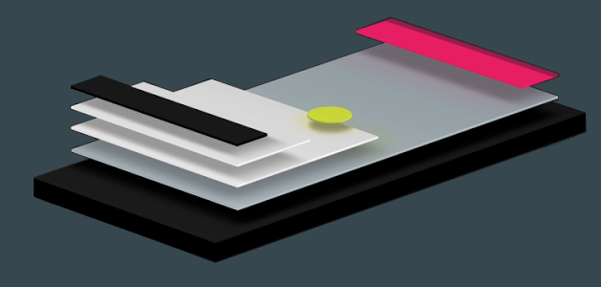
How does Android draw views?
Bottom up approach
Parents drawn before (behind) children
Each ViewGroup is responsible to tell children to be drawn
Each View is responsible of drawing itself
Image Source: https://blogs.adobe.com/creativecloud/xd-essentials-layered-interface-techniques-for-mobile-apps/
Notes:
Bottom up approach
Traverses view from root into the children
Calculates all views that intersect the Invalidated area
Redraws them
ViewGroups can contain other ViewGroups
ViewGroups can contain Views
Views are what are rendered on screen

Slide 5
Two Pass Process
Measure pass implemented in OnMeasure(widthSpec, heightSpec)
Uses two classes to communicate dimensions
Pushes MeasureSpec requirements down the tree from parent to child
Unspecified, Exactly, At Most
LayoutParams allows the developer to request size
Exact number (px, dp, sp, pt), match_parent, wrap_content
At end every View has stored its measurements
GetMeasuredWidth() and GetMeasuredHeight() values must be set also for descendants
Layout pass implemented in OnLayout(left, top, right, bottom)
Takes measurements found in Measure pass and calls OnLayout on children
Each parent is responsible for positioning children
Notes:
Laying out a layout is a two pass process
This is done in a Top Down approach for each pass (top down in terms of tree, parent -> child)
Measuring pass:
Each VIEW pushes dimension specifications down the tree during the recursion this is the MeasureSpec class that is communicated
Unspecified = No restriction of childs dimension for this measurespec
Exactly = Must be exactly this size
At Most = Can be smaller but cannot exceed this size
When OnMeasure method returns, GetMeasuredWidth and GetMeasuredHeight values must be set, along with those for descendants
This is usually done by calling SetMeasuredDimension() or base.OnMeasure()
Don’t do this and IllegalStateException will be thrown!!!!!
Layout pass:
Measurements calculated in Measure pass are used to call OnLayout on children
View should assign a size and position to each of the children

Slide 6
DEMO
OnMeasure, OnLayout and OnDraw in action
Notes:
See https://github.com/Cheesebaron/android-layout-perf Demo solution, press the Verbose button and watch the Output window.

Slide 7
Expensive layouts
RelativeLayout
always runs 2 measure passes
LinearLayout
at least 2 measure passes when using weight
GridLayout
Layout gravity set to fill requires 2 measure passes
Avoid deeply nested hierarchies

Slide 8
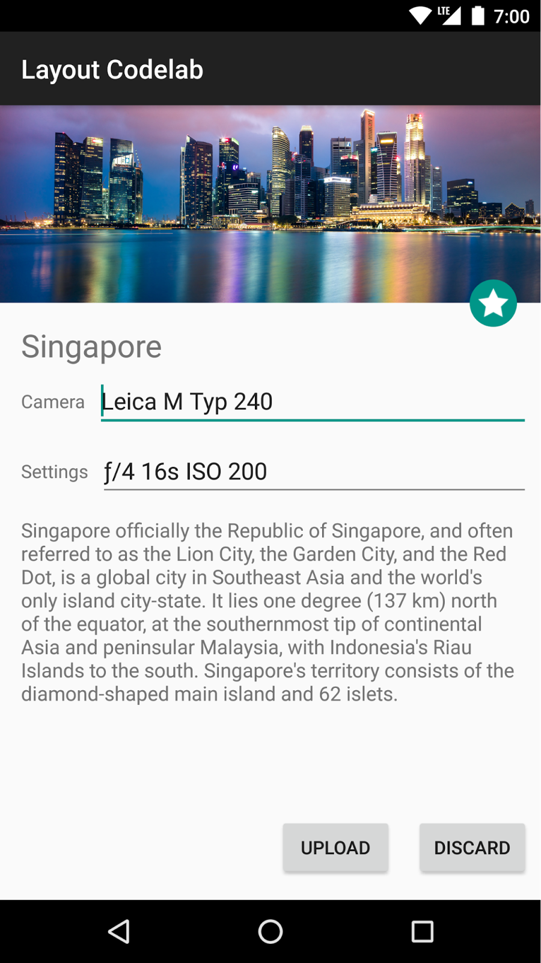
<RelativeLayout>
<ImageView />
<ImageView />
<RelativeLayout>
<TextView />
<LinearLayout>
<TextView />
<RelativeLayout>
<EditText />
</RelativeLayout>
</LinearLayout>
<LinearLayout>
<TextView />
<RelativeLayout>
<EditText />
</RelativeLayout>
</LinearLayout>
<TextView />
</RelativeLayout>
<LinearLayout >
<Button />
<Button />
</LinearLayout>
</RelativeLayout>
<ConstraintLayout>
<ImageView />
<ImageView />
<TextView />
<EditText />
<TextView />
<TextView />
<EditText />
<Button />
<Button />
<TextView />
</ConstraintLayout>
Source: https://android-developers.googleblog.com/2017/08/understanding-performance-benefits-of.html

Slide 9
DEMO
Comparing nested layout to constraints layout
Notes:
See https://github.com/Cheesebaron/android-layout-perf Demo solution, press the Overdraw button and enable GPU overdraw on device

Slide 10
What is overdraw?
Drawing the same pixel multiple times in the same frame of rendering
Happens when
Having a number of stacked layouts
Each layout hides a portion of the one below it

Slide 11
How to fix overdraw?
Removing unneeded backgrounds
Flattening the view hierarchy
Reducing transparency

Slide 12
DEMO
Visualizing overdraw and common fixes
Notes:
See https://github.com/Cheesebaron/android-layout-perf Demo solution, press the Overdraw button and enable GPU overdraw on device

Slide 13
Why custom views?
Reduce complex view hierarchy
Desired view does not exist
Existing views are not good enough or cannot be extended

Slide 14
DEMO
Look at a custom view

Slide 15
What to keep in mind in OnDraw?
Don't take too long
A frame at 60 FPS is around 16ms
Stay away from allocating new paints and drawing objects in OnDraw
Reuse existing ones
Do not use large Paths if you are modifying them next frame. Use line, circle and other methods on canvas
Do not draw bitmaps larger than the canvas
If you are using bitmaps for caching. Call SetLayerType(LayerType.Hardware)
ClipPath() is super expensive!

Slide 16
Resources
https://developer.android.com/guide/topics/ui/how-android-draws.html
http://www.vogella.com/tutorials/AndroidCustomViews/article.html
https://developer.android.com/topic/performance/rendering/optimizing-view-hierarchies.html
https://developer.android.com/studio/profile/inspect-gpu-rendering#profile_rendering
https://developer.android.com/topic/performance/vitals/render.html
https://android-developers.googleblog.com/2017/08/understanding-performance-benefits-of.html

